Slide 1
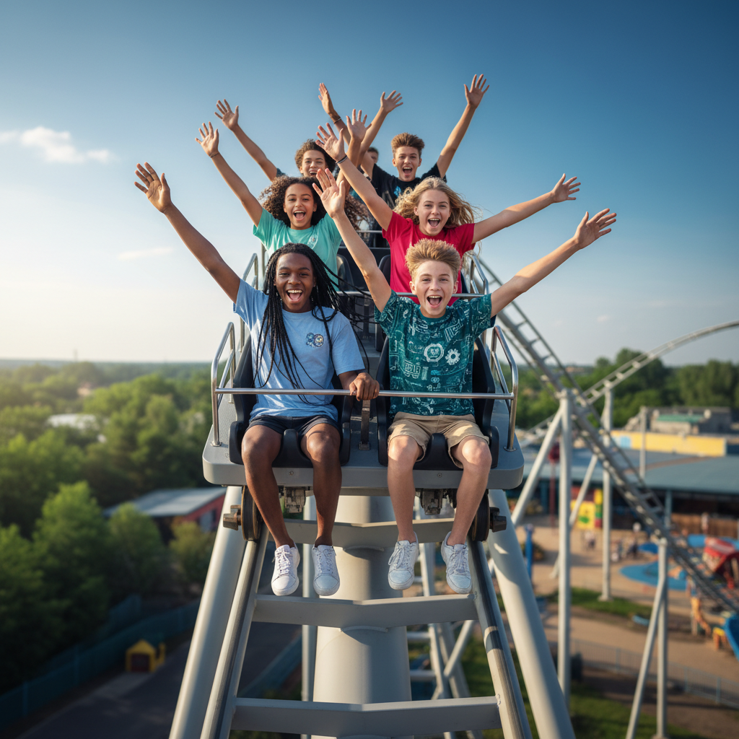
ModelIt!
Student Lesson
The Roller Coaster Equation
How Physics Turns Height Into Speed and Screams Into Science
NGSS: MS-PS3-1, MS-PS3-2
8th Grade
1/9

Slide 2
What You Will Learn Today
Learning Goals
* Explain the relationship between potential energy and kinetic energy
* Model how height, mass, and speed are connected in energy transformations
* Predict the speed of a coaster at any point on the track using energy conservation
* Evaluate real roller coaster designs using energy transformation principles
Key Vocabulary
Kinetic Energy
The energy of motion — increases with speed and mass
Potential Energy
Stored energy due to position or height — increases with height and mass
Energy Conservation
Energy cannot be created or destroyed, only transformed from one form to another
Energy Transformation
The process of energy changing from one type to another
2/9

Slide 3
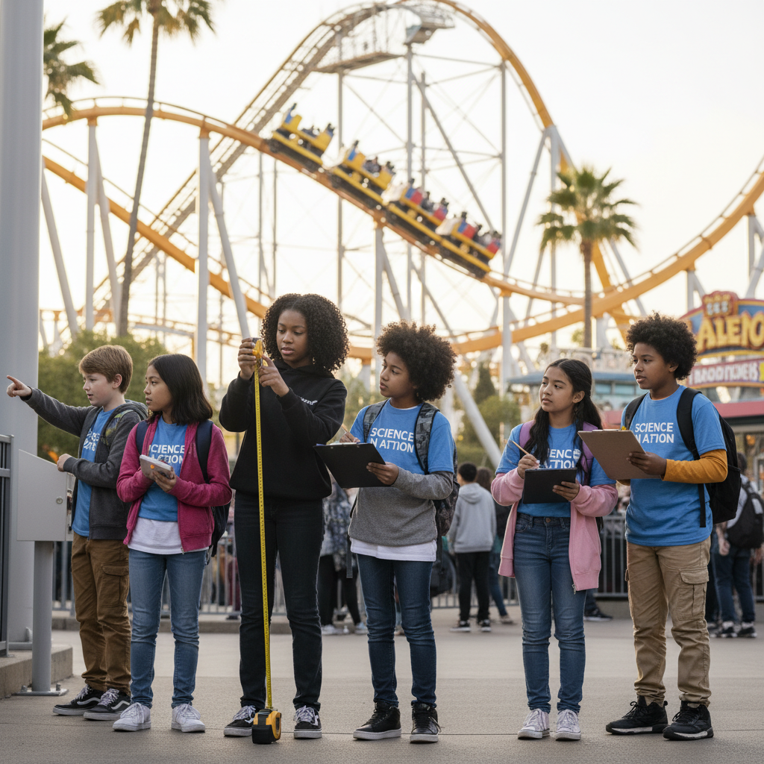
The Big Question
How does a roller coaster turn height into speed without an engine?
How Physics Turns Height Into Speed and Screams Into Science. Today we'll build a MODEL to discover the answer!
3/9

Slide 4

Today We Will Build a Model!
A model helps us understand complex systems!
1. LOCATE
Identify the COMPONENTS (parts) of the system
2. ESTABLISH
Connect them with RELATIONSHIPS (+ or -)
3. VISUALIZE
Build your model in ModelIt!
4. EVALUATE
Run SIMULATIONS to test scenarios
5. REVISE
Improve your model based on evidence
4/9

Slide 5

Activity 1: Sort the Components
Sort these components into EXTERNAL (inputs from outside) and INTERNAL (inside the system):
Your Components:
* Coaster Height
* Coaster Mass
* Potential Energy
* Kinetic Energy (Speed)
Think: Which components can we control? Which happen on their own?
5/9

Slide 6
Activity 2: Connect with Arrows
Draw arrows to show HOW components affect each other:
(+) POSITIVE Relationship
When one goes UP, the other goes UP too
(-) NEGATIVE Relationship
When one goes UP, the other goes DOWN
Think About It:
When the coaster is at the TOP of the first hill, it has maximum potential energy. What happens to that energy as it drops?
6/9

Slide 7
Activity 3: Run the Simulation!
Test these scenarios in ModelIt!
First Drop
Set Coaster Height to maximum and watch the energy transformation
Heavy vs. Light
Compare a fully loaded coaster vs. a nearly empty one
Loop the Loop
Set height to include a loop and predict minimum speed needed
Watch the activity graphs change!
[ModelIt Platform Screenshot - Simulation Results Graph]
7/9

Slide 8
What Did We Discover?
Our Model Showed Us:
* At the top of the hill: maximum potential energy, minimum kinetic energy
* At the bottom: maximum kinetic energy, minimum potential energy — the energy TRANSFORMED
* The total energy stays the same (conservation!) — height energy becomes speed energy
* More mass means more of BOTH types of energy, but the speed at the bottom is the same
Answer: A roller coaster converts potential energy (height) into kinetic energy (speed). The higher the first hill, the faster the coaster goes at the bottom — no engine needed!
8/9

Slide 9
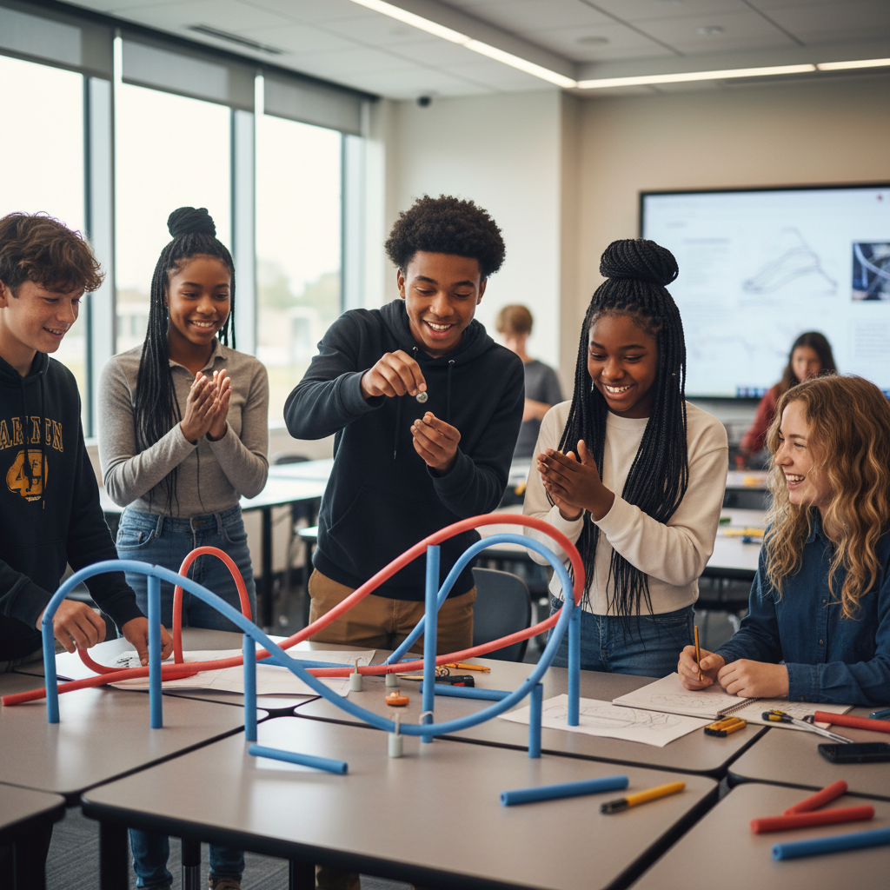
STEM Challenge: Design the Ultimate Roller Coaster
YOUR ENGINEERING MISSION
Design a roller coaster that achieves the maximum thrill while obeying the laws of energy conservation.
The Challenge:
A theme park has hired your engineering team to design their new signature roller coaster. It must be thrilling but physically possible — every hill, loop, and turn must obey energy conservation.
Think Like an Engineer:
* Why can't the second hill be taller than the first?
* What's the minimum speed needed to safely complete a loop?
* How does friction affect your design?
REAL CAREER CONNECTION: Roller Coaster Engineers and Mechanical Engineers design rides using physics principles. They use computer models to test designs before building. They earn $75,000-$130,000/year. The skills you're using TODAY are the same ones they use on the job!
9/9

